Slide 1


Probabilistic thunderstorm forecasts using Harmonie and ECMWF predictors with logistic regression and machine learning technique(s)
Date: 2 April 2019
By Edward Groot
Supervisors: Maurice Schmeits (KNMI), Kirien Whan (KNMI), Willem Jan van de Berg (IMAU)

Slide 2

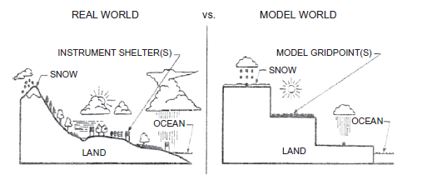
Why statistical post-processing?
Direct model output (DMO) from a numerical weather prediction (NWP) model is biased, because
Model has gridboxes which represent gridbox average conditions
Also: missing physics & chaos in the system
Allows to quantify uncertainty from deterministic output
We can correct systematic errors!

Slide 3
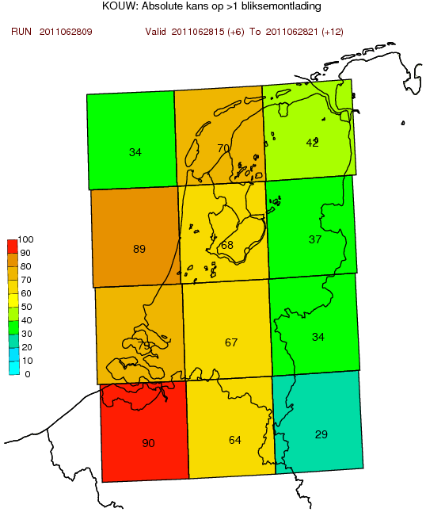
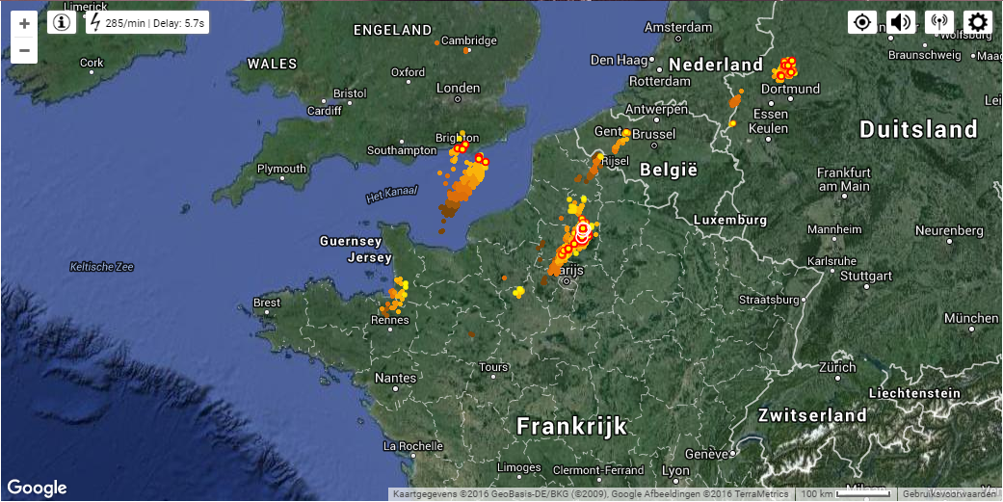
Predictand
1. Occurrence of 2 or more lightning discharges within a region, “thunderstorm event”
2. Maximum intensity within region, number of discharges / 5 min
Based on KNMI lightning detections (as “truth”)
Any lightning detection dataset is not 100% accurate
Netherlands distributed in 12 regions; 6 hour time bins

Slide 4
Methodology
Use and compare (extended) logistic regression & quantile regression forests (all multivariate)
Derive conditional thunderstorm probabilities; conditional on predictors from NWP model output
Old system: heavily leaning on instability indices and convective precipitation from hydrostatic HIRLAM + ECMWF
New system based on non-hydrostatic Harmonie: e.g. vertical velocity, cloud ice & graupel content
Algorithms for predictor selection/elimination from potential predictor set

Slide 5
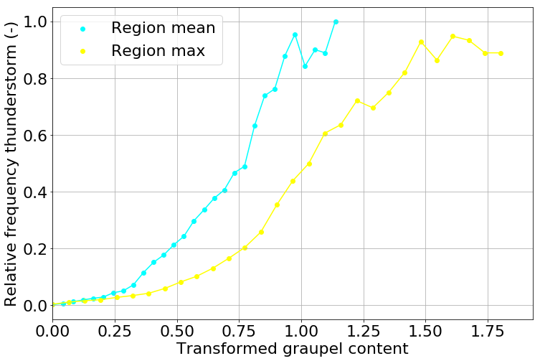
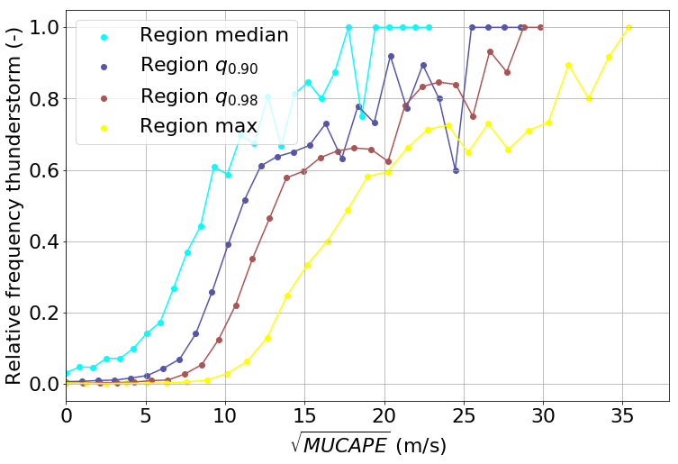
Methodology
Build models for conditional thunderstorm probability
Conditional on model predictors (examples below)
Unstable (statistically)
Unstable (statistically)
Transformed Harmonie graupel @ power 0.2
Sqrt(Most Unstable CAPE); entrainment corr.

Slide 6
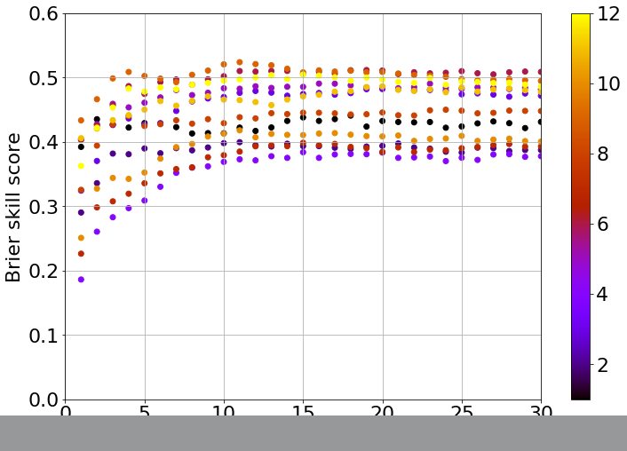
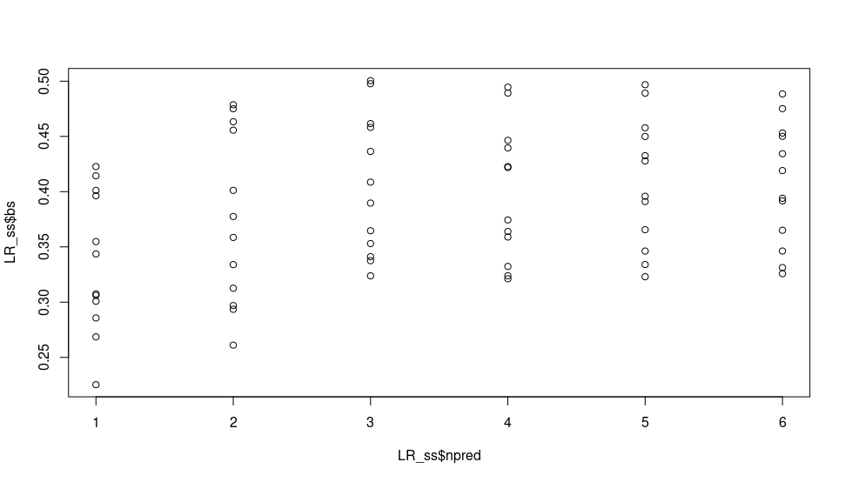
Preliminary result (example)
Brier skill score as function of number of predictors
quantile regression forests: initial cross-validation Region no.
Logistic regression: initial cross-validation
Brier Skill Score
Same 12 regions
No. predictors →
No. predictors →

